Slide 1
Mobile Learning for Primary Health Workers
Roman Blanco, MD, PhD

Slide 2
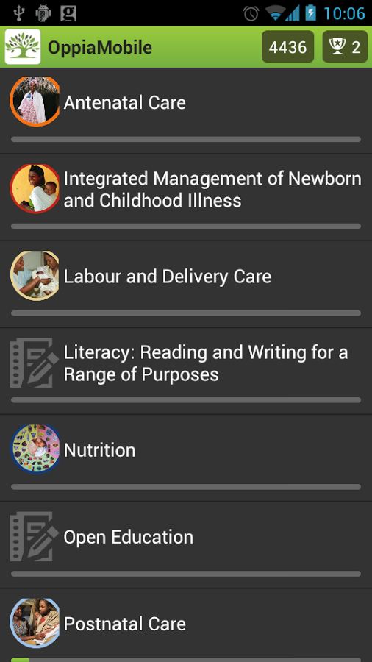
Digital Campus
Start-up based in UK focused in the use of mobile technologies for learning and health
Turnkey solutions
Agile development
Evidence-based approach

Slide 3
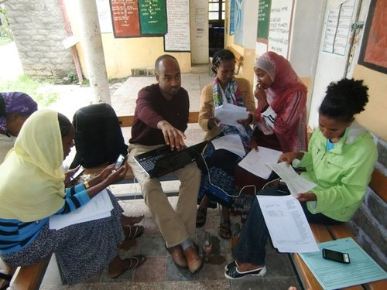
Problem context
Primary health workers generally under-trained
Existing training very text-heavy
Little follow up on how the skills and knowledge learned are applied

Slide 4
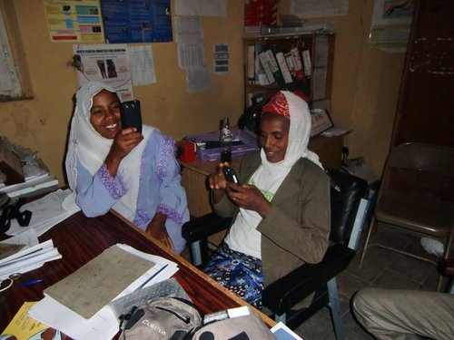
Our project
Supplementing existing national training programme
Giving health workers access to videos, quizzes and other activities via mobile devices
18 month follow up with continuous professional development activities to monitor application of skills/knowledge
Funded by UKaid (DFID)

Slide 5
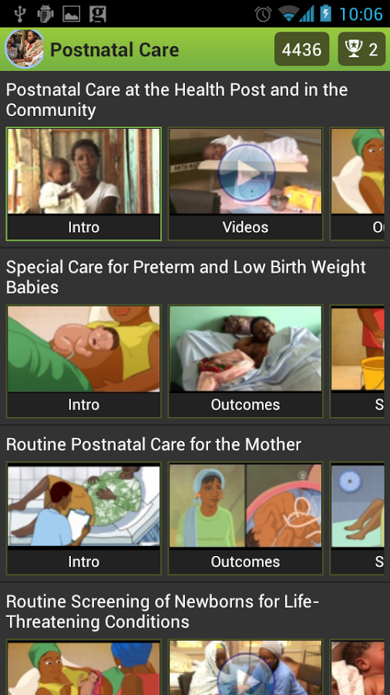
Oppia Mobile
Open Source mobile learning application
Supports video, quizzes and other activities
Works when completely offline – all activities stored on device
Especially designed for mobile users with poor internet connectivity

Slide 6
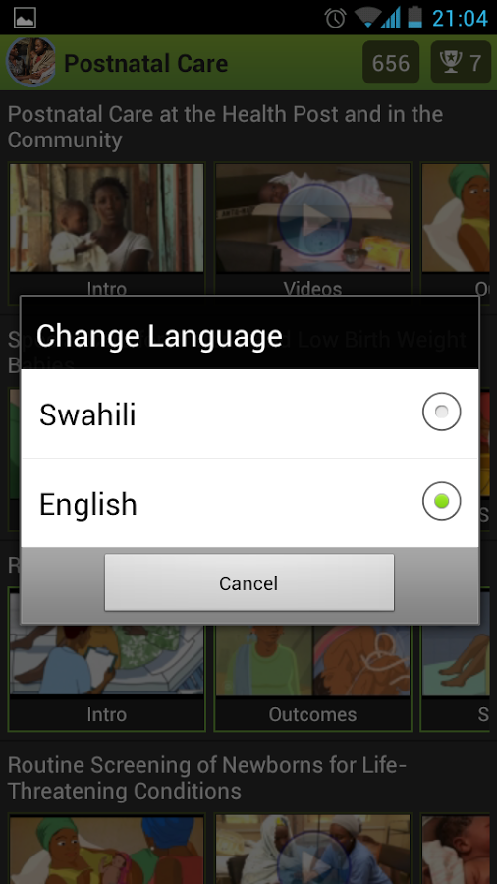
Oppia Mobile
Currently designed for Android, but can be extended to other platforms
Designed to support existing or new training and teaching programmes in all professional areas
Supports multilingual content
Text to Speech – the client app can “read aloud” text pages

Slide 7

How it works
Course content can be collaboratively edited and produced in Moodle
No need for programmers to maintain and update learning content
Exported to package that can be installed on mobile devices

Slide 8
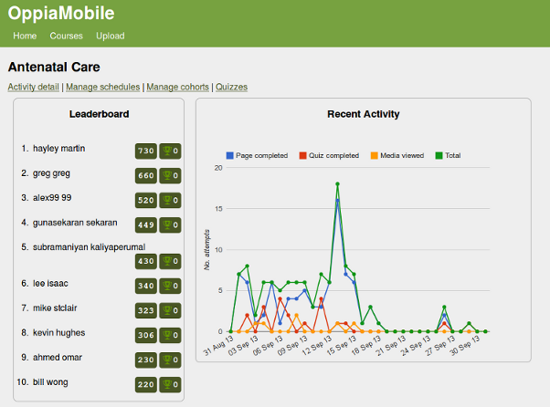
How it works
Activity tracking, quiz results, video views all submitted to server – trainers and supervisors can track student progress
Students gain points and “badges” based on their usage and quiz scores (gamification)

Slide 9
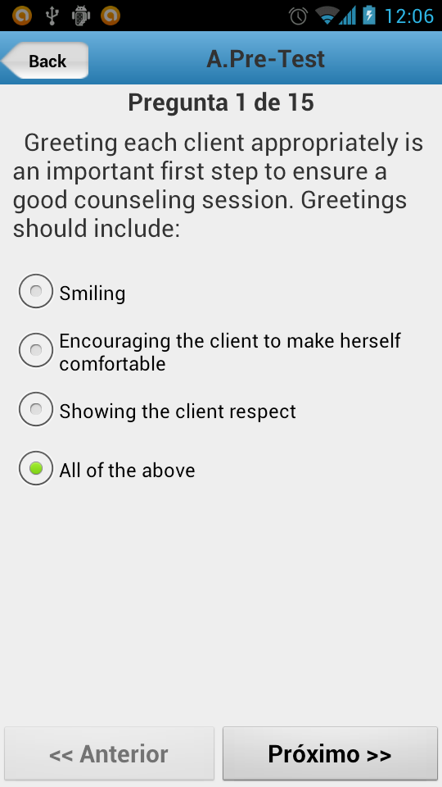
Customised versions
All open source - can install your own server and create your own client app
Use your own themes/logos for the client application
Currently being implemented for Family Planning counselors in Nigeria with project from Johns Hopkins University

Slide 10
Customised versions
All open source - can install your own server and create your own client app
Use your own themes/logos for the client application
Currently being implemented for Family Planning counselors in Nigeria with project from Johns Hopkins University

Slide 11
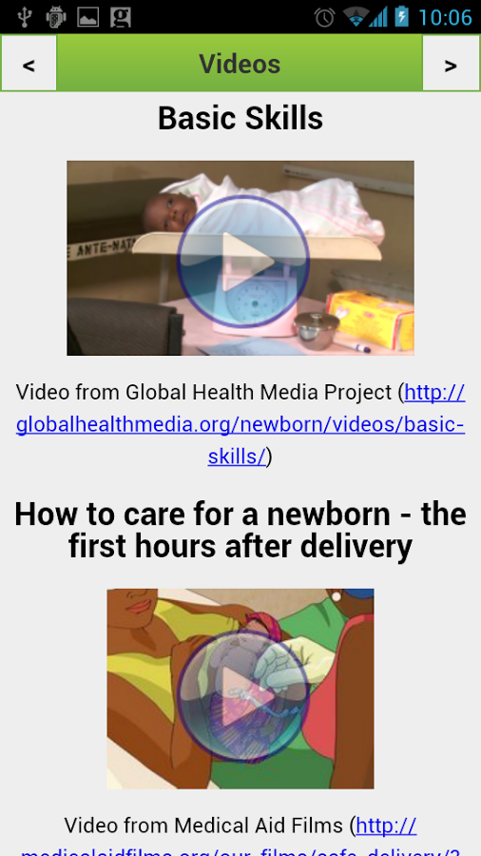
Current work
Core application already available
Develop trainer/tutor monitoring tools
Improved ease of use for customisation and packaging
New activity types – to support problem based learning approaches

Slide 12
Further info/links
Get the app on Google Play
Documentation: http://oppia-mobile.org
Recent articles:
  PLOs One (fully accepted, awaiting publication)
  BMC Human Resources for Health http://www.ncbi.nlm.nih.gov/pubmed/23171076

Slide 13
Thanks!
Contact us at:
roman@digital-campus.org

